Slide 1

The Palantir Seeing Stone
Used by individuals of great power to communicate over long distances
Created during the First Age by the Elves of Valinor
Reveals anything except darkness and shadow
Comes in various sizes— from a foot in height to filling a chamber
Lies beyond the skill of most wizards to create

Slide 2

The Palantir Analysis Platform
Used by the governments of the western world and their allies to collaborate over complex data sets
Replaces billion dollar programs at 5% the cost, 1% the time, and works out of the box (0% of the risk)
Created in 2004 by the co-founder of PayPal and a team of Stanford computer scientists
Integrates data sets of various sizes— from a few thousand records to hundreds of millions records– for thousands of analysts to collaborate on
Lies beyond the skill of typical coders to create

Slide 3
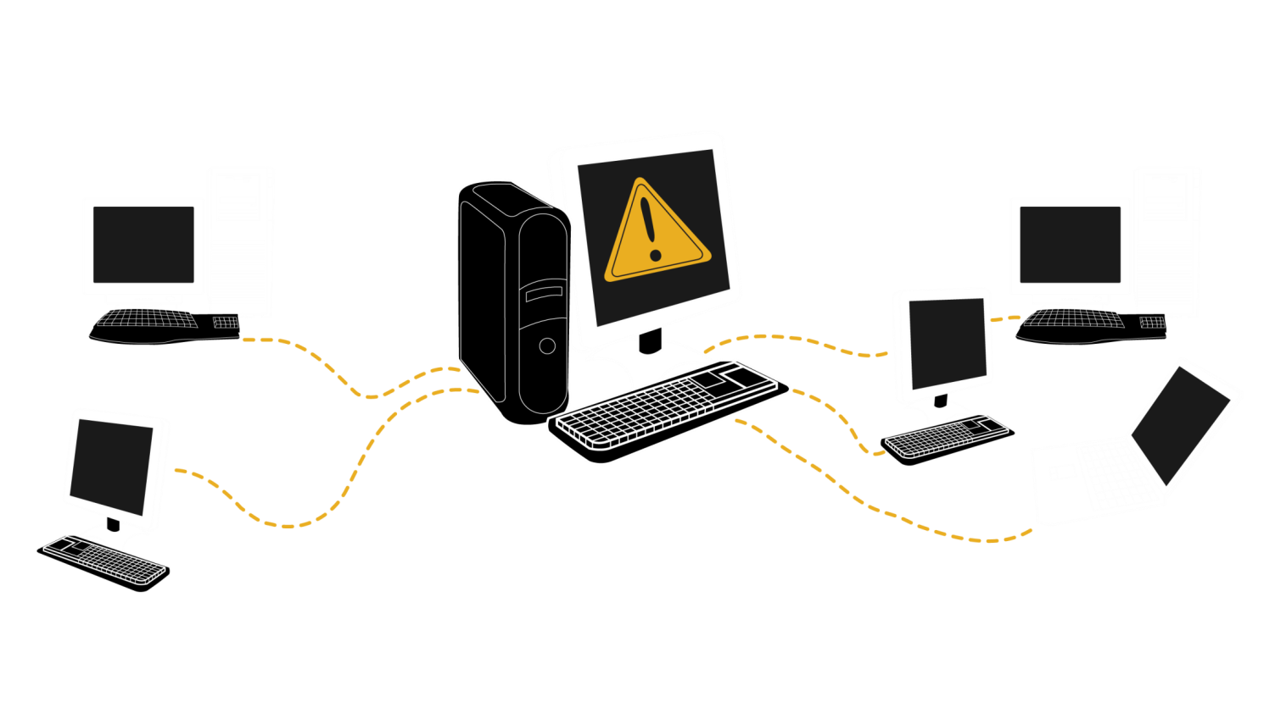
PayPal >>>>> Palantir
PayPal wasn’t about sending money; it was about sending money without being defrauded by the Russian mob.

Slide 4
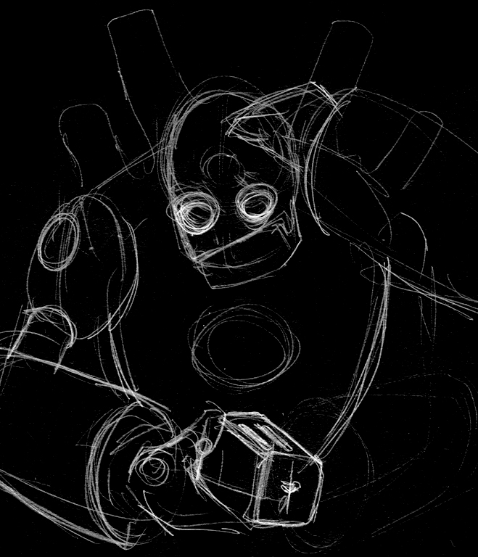
AI/Machine Learning Isn’t Enough...
Artificial Intelligence (AI)
Intelligence Augmentation (IA)
Machines couldn’t catch the fraud, Humans couldn’t scale to the data

Slide 5
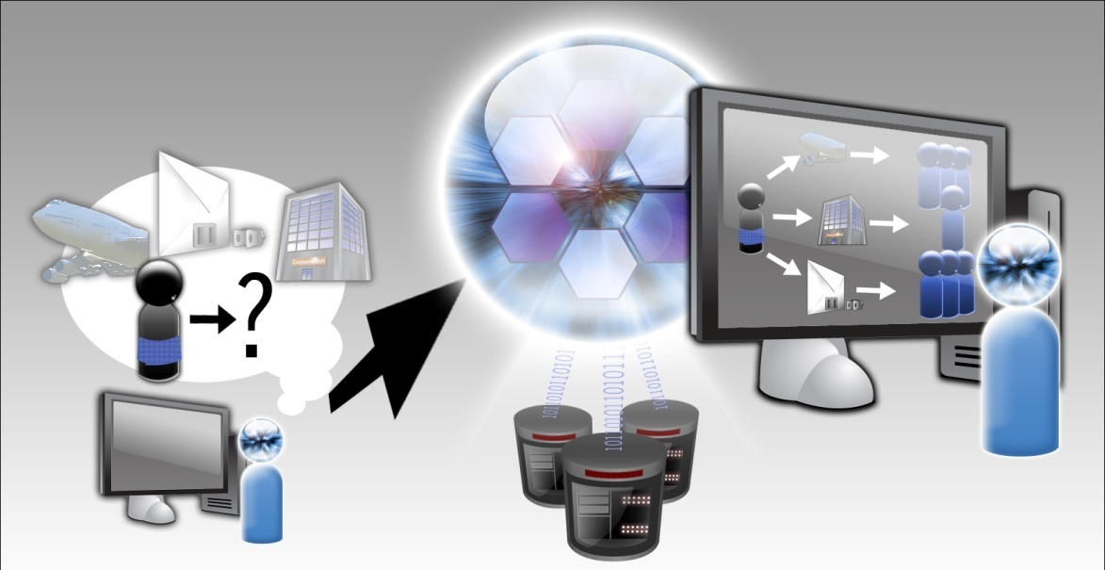
What Does Work?
Human-Driven Analysis
Using the Computer as a massive lever
Augmenting Human Intelligence

Slide 6
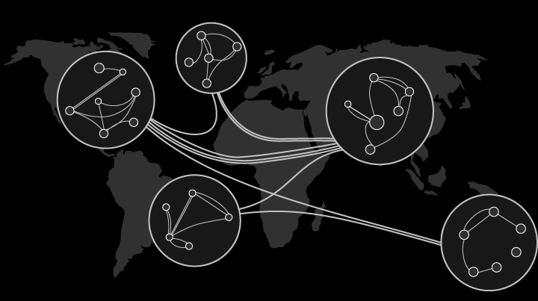
Founded to Solve Our Nation’s Hard Problems

Slide 7
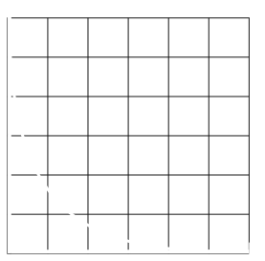
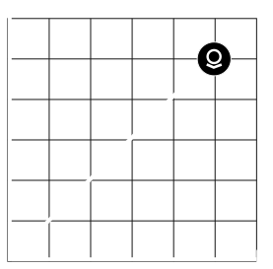
Escaping The False Tradeoff
Combating
Terrorism
Protecting Civil Liberties

Slide 8
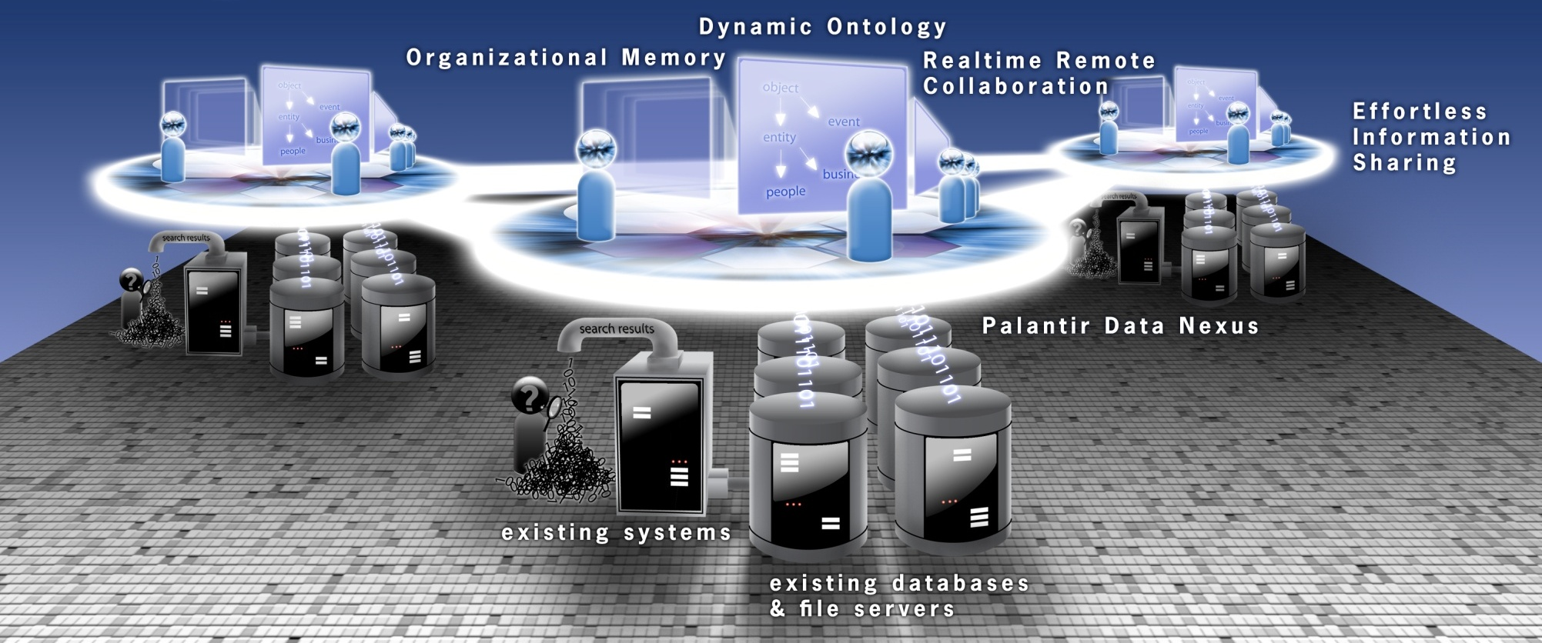
Same Problem, Different Mission,
Different Bespoke Project… Same Product
Products, not Projects

Slide 9
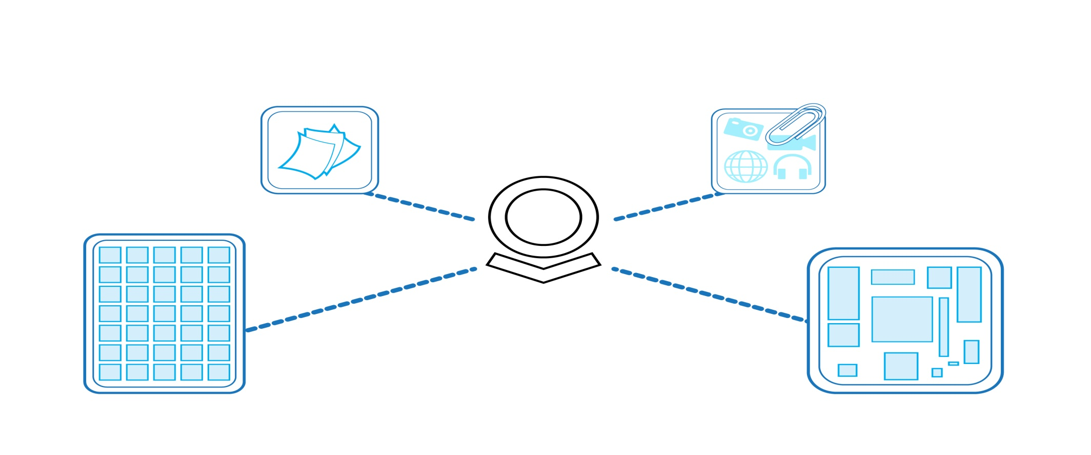

Data Integration

Slide 10
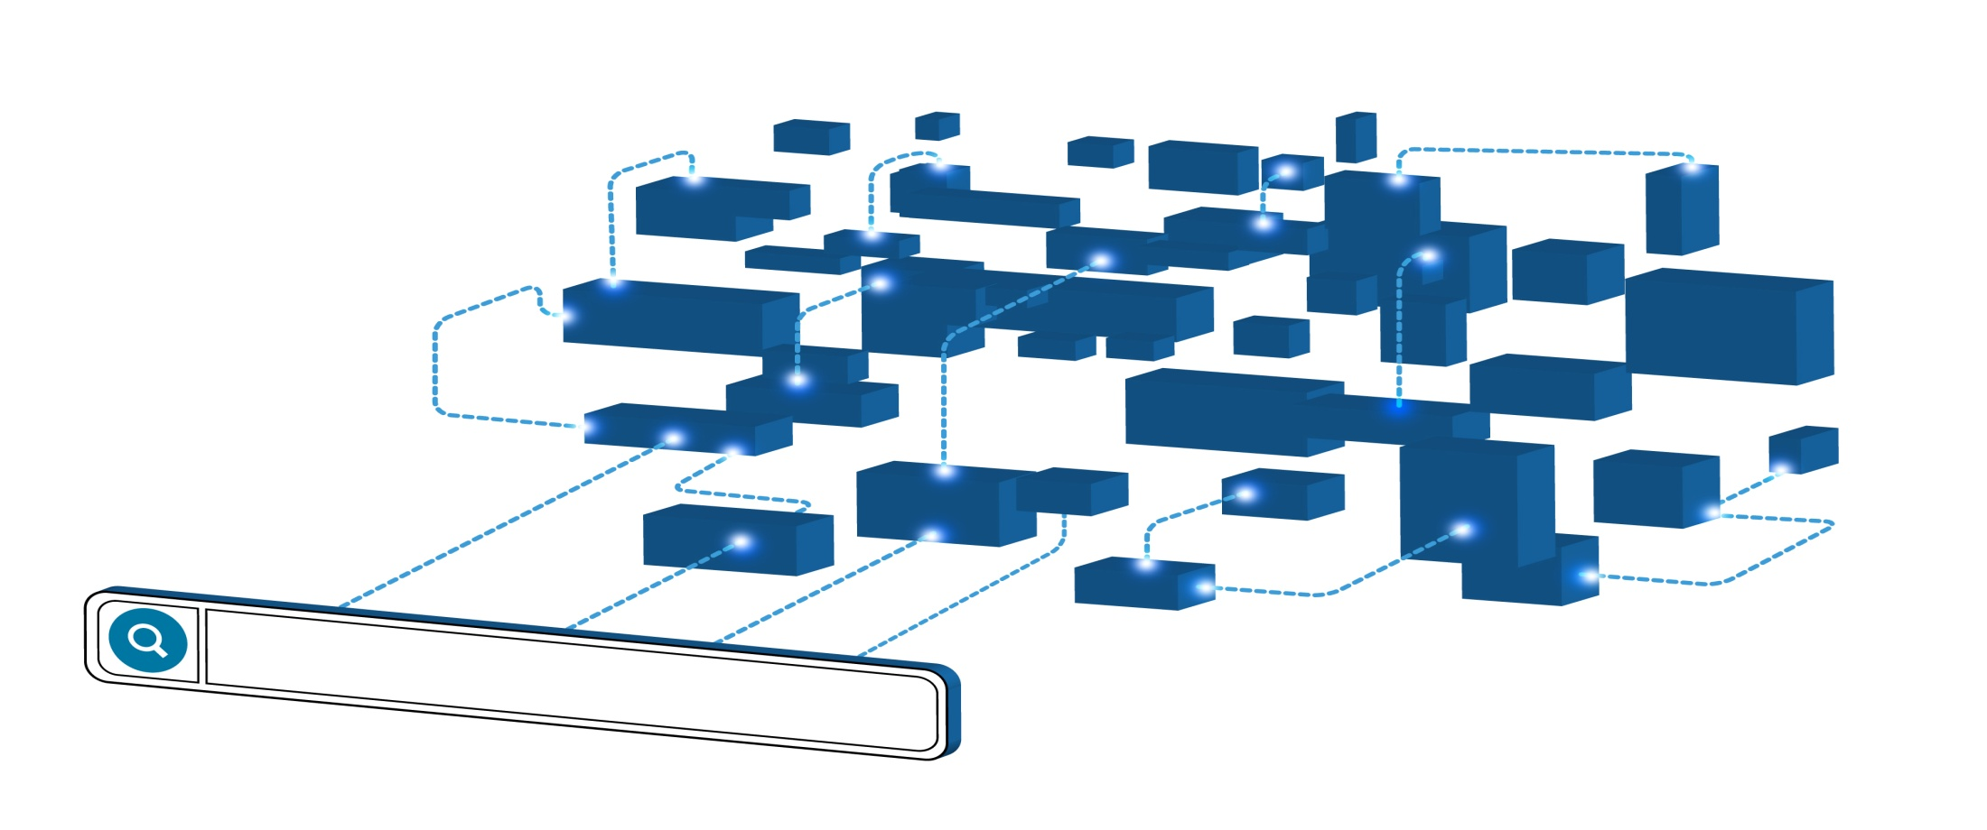
Search and Discovery

Slide 11


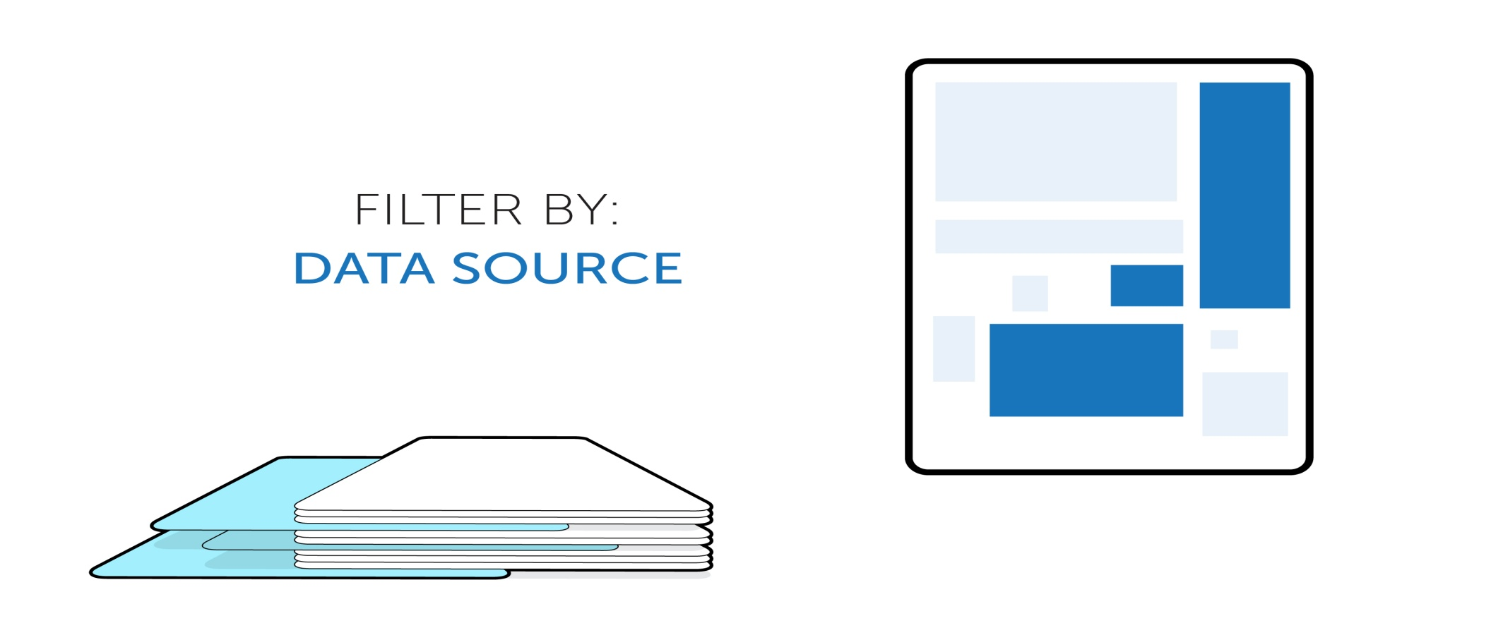
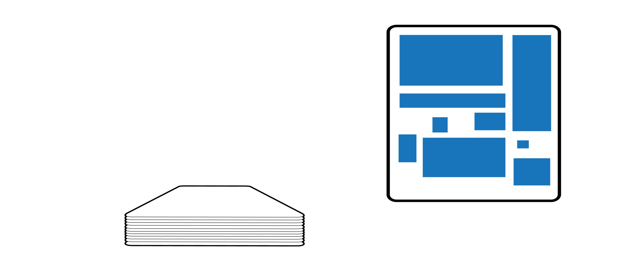
Knowledge Management

Slide 12
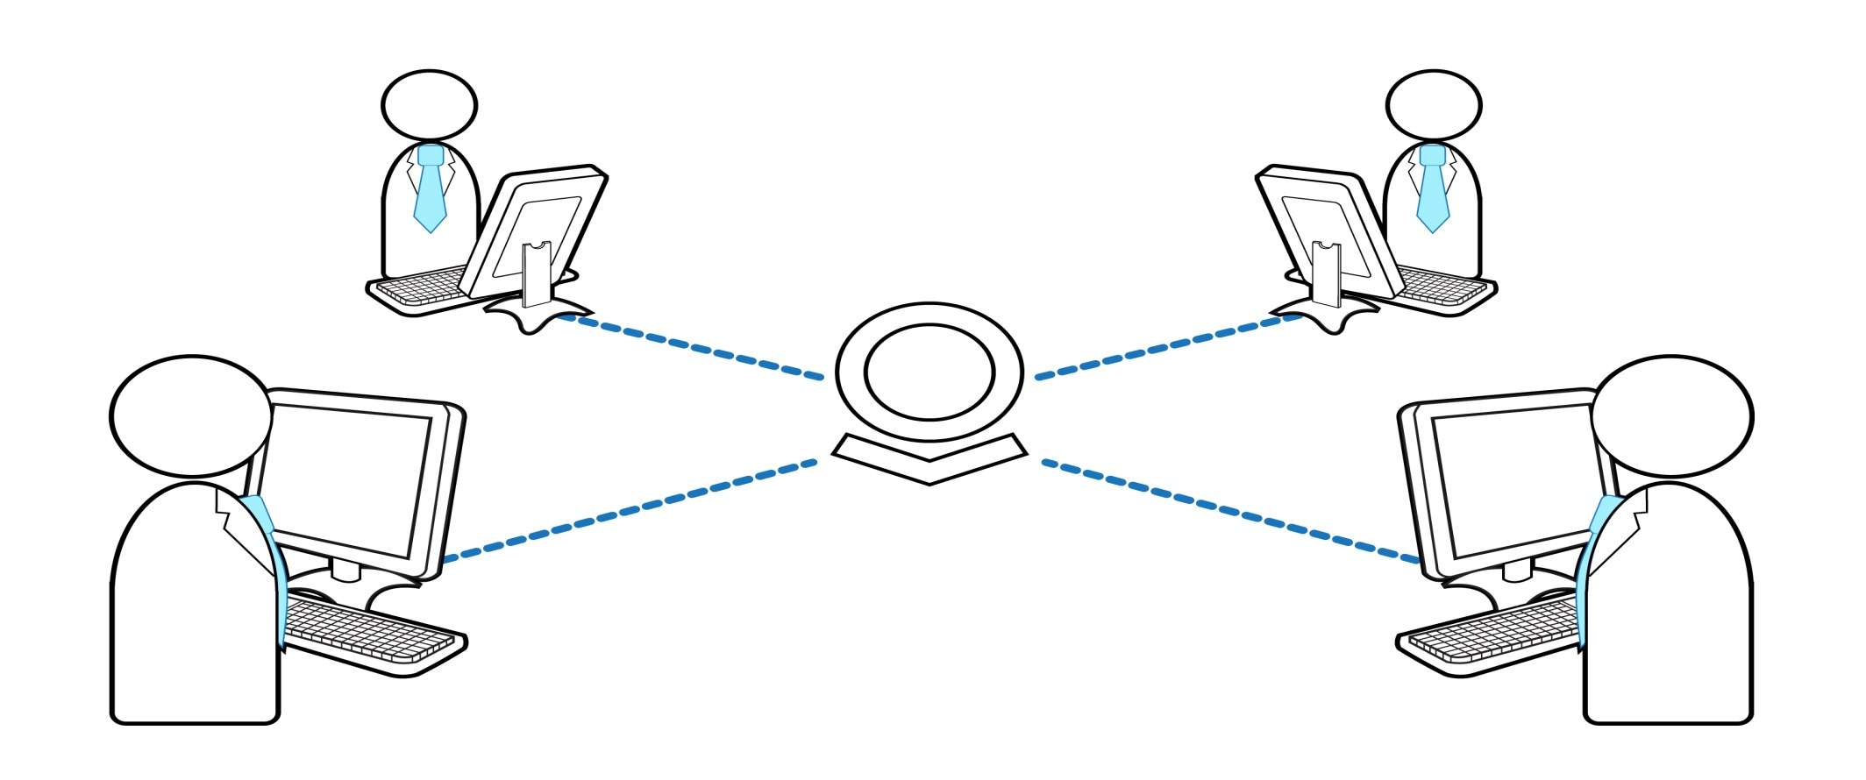
Collaboration

Slide 13
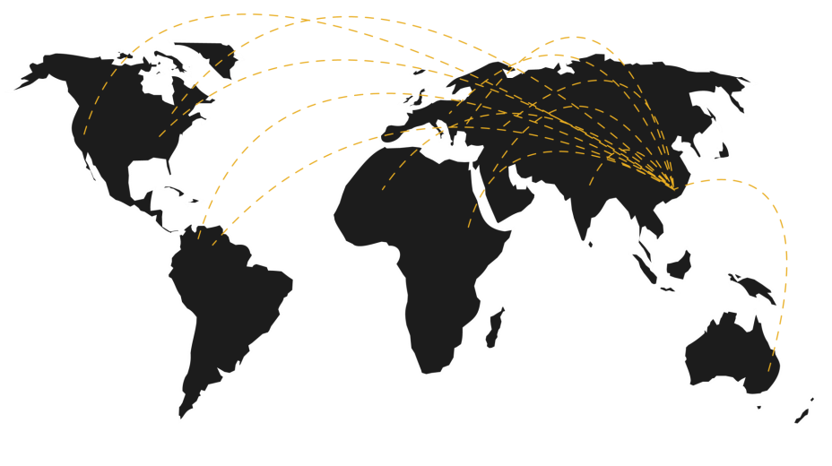
Projects
  The Platform in IC/Defense
  Regulation, Oversight, Transparency
  Healthcare
  Open Projects
  GhostNet
  Sinjar Records
  GreyGoose
  CPI’s subprime meltdown

Slide 14
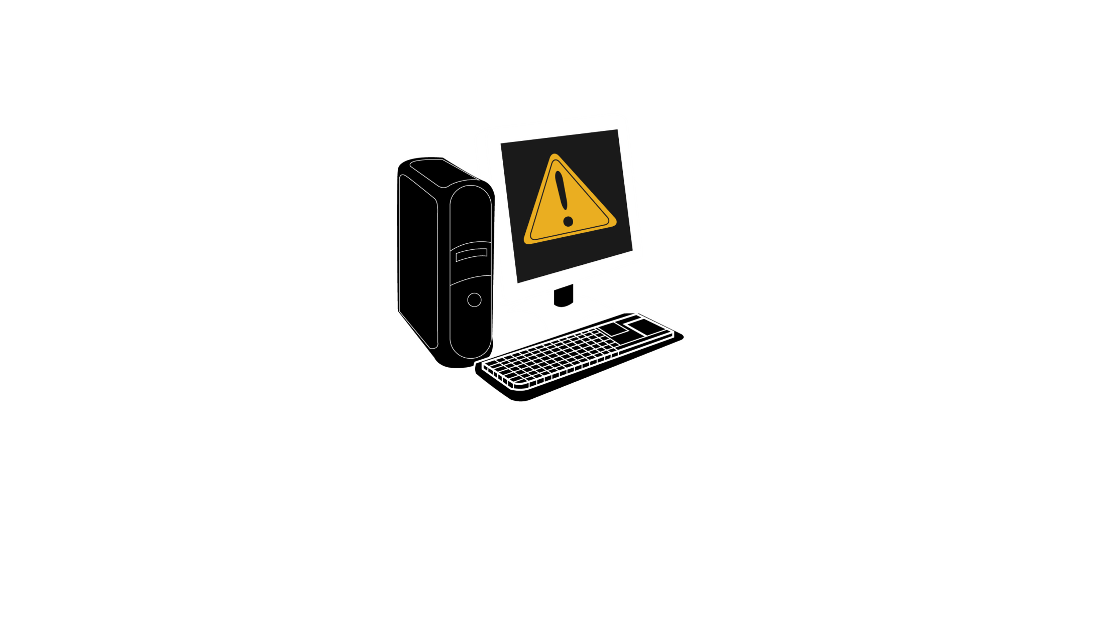
Who Broke Into The Computer?
The Office of His Holiness The Dalai Lama

Slide 15

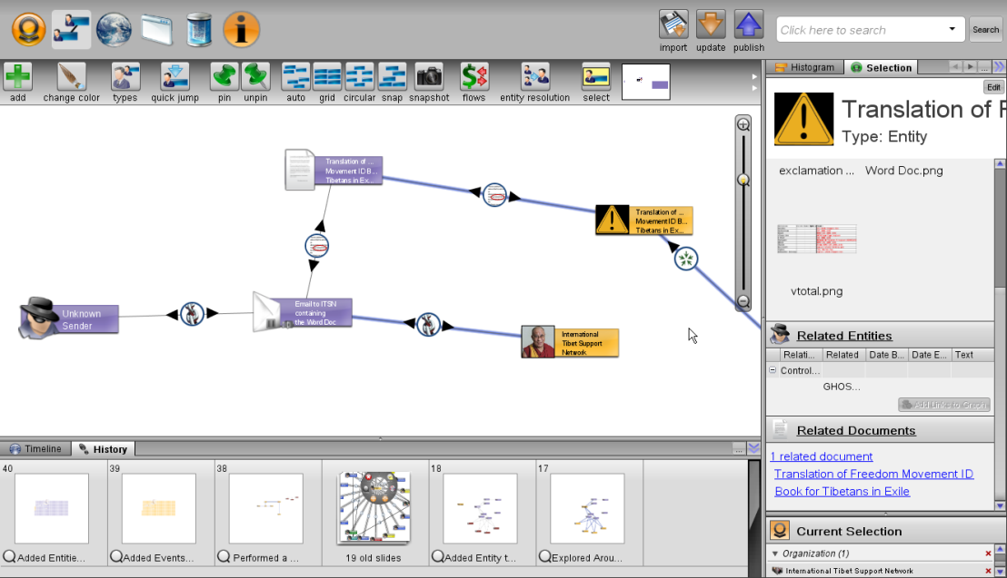
Palantir Reveals… GhostNet

Slide 16
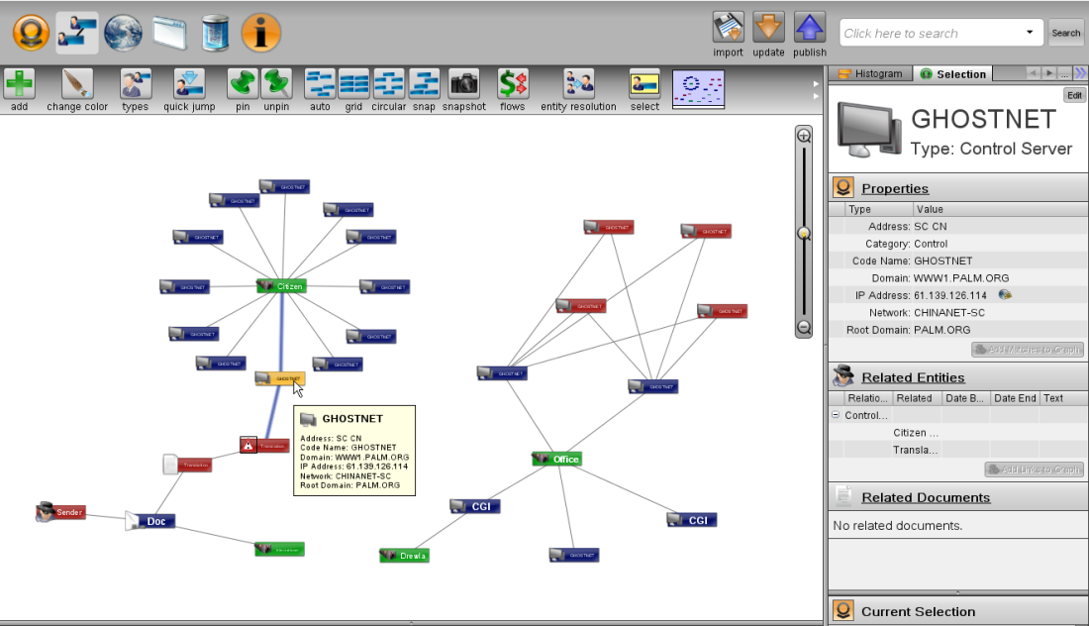
Palantir Connects…

Slide 17
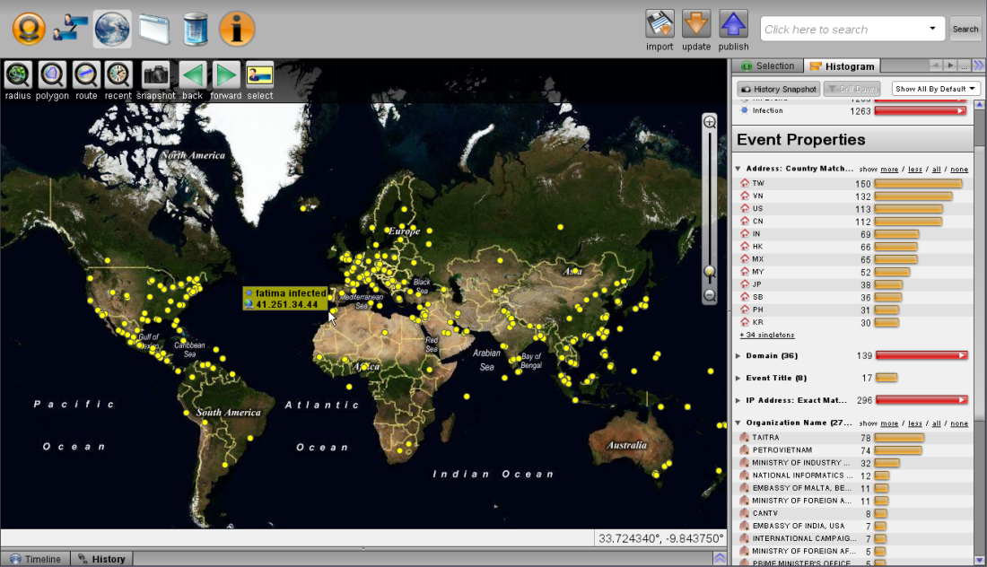
Palantir Explains…

Slide 18
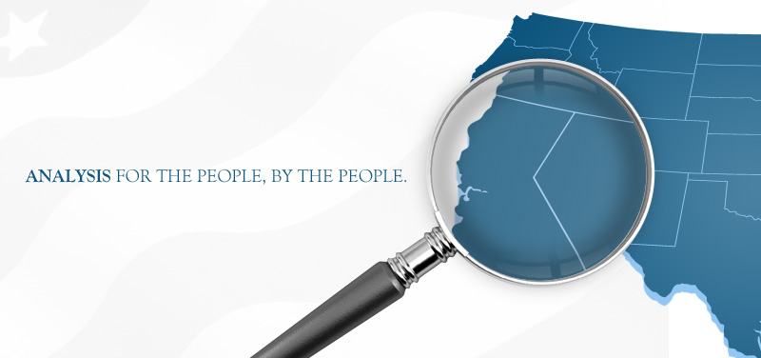
And now… AnalyzeThe.US

Slide 19
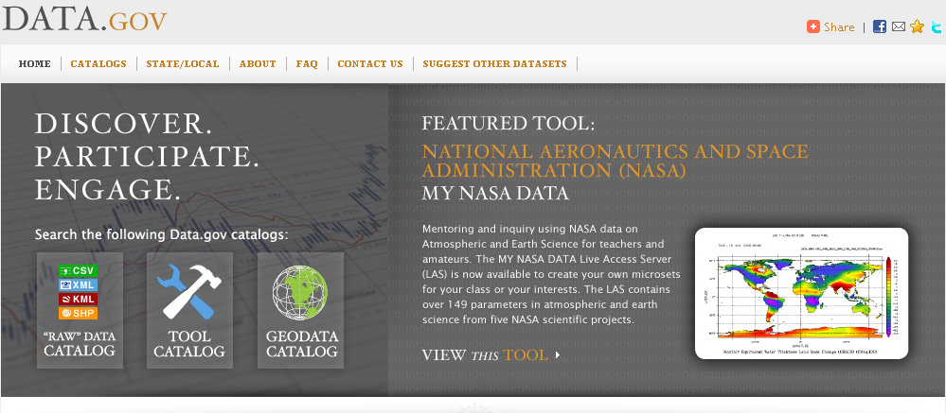
Because Government is a Platform… and there is a lot of Data.gov

Slide 20

Analysis For the People, By the People

